Slide 1

Uses for LWIR and LiDAR Sensor Fusion in Relation to sUAS Detection
Jonathan M. Buchholz
Iacopo Gentilini

Slide 2
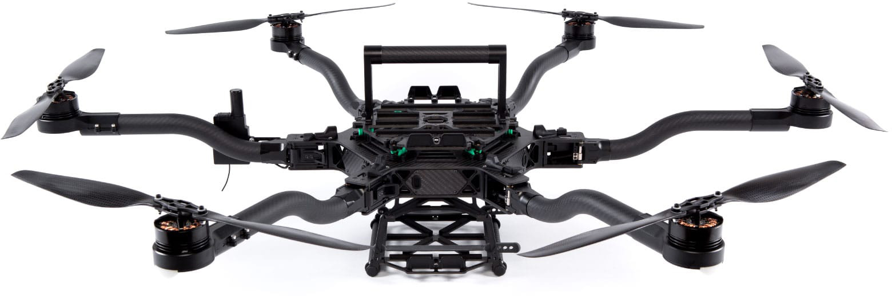
Introduction
Rise of small Unmanned Aerial System (sUAS)
NASA’s UAS Traffic Management (UTM)
Methods require sensing capabilities
  Detection
  Location
  Categorization
Long Wave InfraRed (LWIR)
Light Detection and Ranging (LiDAR)
Sensor fusion
(freeflysystems.com/alta-6/specs)

Slide 3
Methodology
Perform trade study of available sensors
Performance
Cost
Weight
Raspberry Pi 3
  Small
  Simple
Choose processor
Arrange data capture method
GPIO trigger for LWIR
ROS packages for LiDAR
Research sensor fusion methods
General fusion
LiDAR and visible
for reference
Develop sensor fusion algorithm
Geometric
transformations
Pixel-level correlation
Design sensor mount
CATIA
3D printed

Slide 4

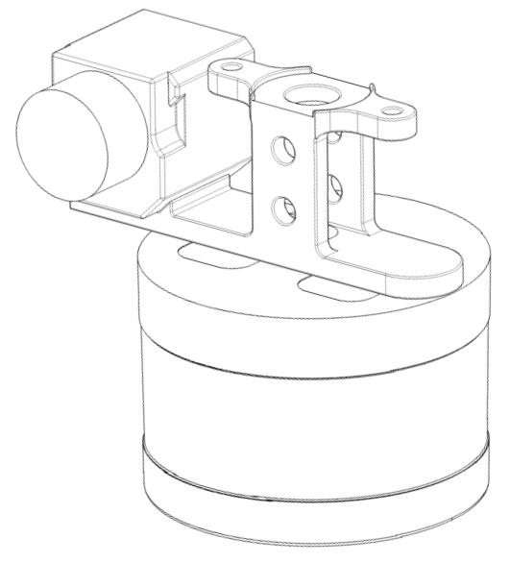

Sensors and Specifications
(www.FlirMedia.com)
(www.VelodyneLiDAR.com)
FLIR® VUETM Pro
LWIR Camera
7.5 - 13.5 µm wavelength
336x256 resolution
35° HFOV, 27° VFOV
30 FPS
Velodyne® PuckTM LITE
LiDAR Scanner
903 nm wavelength
360° HFOV, 30° VFOV
100m effective range, ±3cm
~300,000 points per second

Slide 5
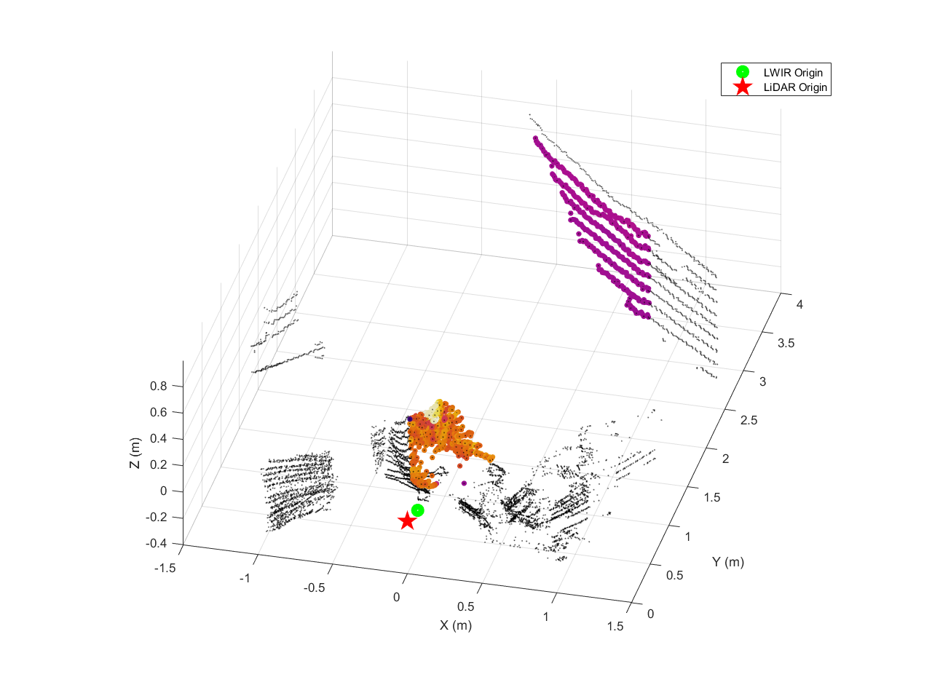
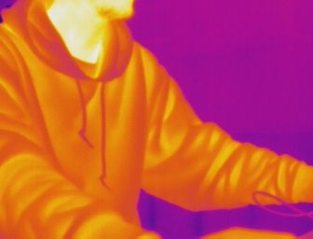
Sensor Fusion Algorithm
Geometric transformations
Pixel-level color correlation

Slide 6
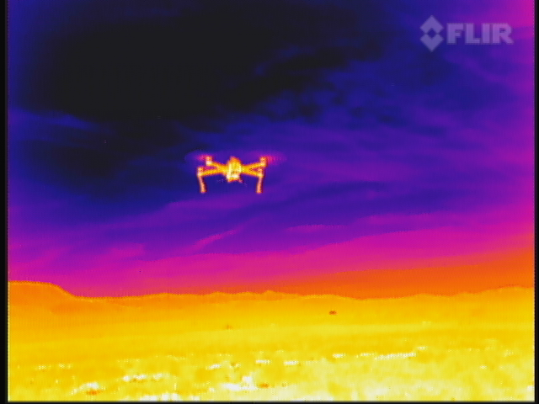
Conclusion
Sensor fusion advantages:
  LWIR contrast
  LiDAR depth
  Independent of visible spectrum
Machine Learning (ML) Compatibility
  Fused data for training neural networks
  Recognition in addition to detection and localization
Use on sUAS
  Lightweight design
(Siewert, 2013)

Slide 7


Challenges
Mostly software-based:
Linux environment
ROS architecture
BASH scripting
Python
(www.ROS.org)
(www.Python.org)

Slide 8
Future Work
Prepare automated data capture
Adapt fusion
algorithm to RTOS
Python & Bash
Guaranteed data sync
C, C++ conversion
Refinement of algorithm
Capture data from sUAS platform
Compile data for ML functionality
ALTA 6
Preliminary flight data
Explore DAA methods
Publish data sets

Slide 9
The Larger Picture
Drone Net
ERAU Prescott & CU Boulder
Graduate and undergraduate
Detection, localization, classification of sUAS in Class G airspace
Challenging effectiveness of RADAR
  Reliability
  Cost
(Siewert, 2018)

Slide 10
Acknowledgements
Dr. Iacopo Gentilini
Dr. Sam Siewert
Dr. Anne Boettcher
Dr. Jonathan Gallimore
Jim Weber

Slide 11
Questions?
Please contact:
Jonathan M. Buchholz
buchholj@my.erau.edu

Slide 12
Thank You

